Slide 1
Neural Networks and Neural Language Models

Slide 2
Introduction
A modern neural network is a network of small computing units, each of which takes a vector of input values and produces a single output value.
Here, we introduce the neural net applied to classification. The architecture we
introduce is called a feedforward network because the computation proceeds iteratively from one layer of units to the next.
The use of modern neural nets is often called deep learning, because modern networks are often deep (have many layers).

Slide 3
Introduction
Neural networks share much of the same mathematics as logistic regression. But neural networks are a more powerful classifier than logistic regression, and indeed a minimal neural network (technically one with a single ‘hidden layer’) can be shown to learn any function.
Neural net classifiers are different from logistic regression in another way. With logistic regression, we applied the regression classifier to many different tasks by developing many rich kinds of feature templates based on domain knowledge. When working with neural networks, it is more common to avoid most uses of rich hand derived features, instead building neural networks that take raw words as inputs and learn to induce features as part of the process of learning to classify.

Slide 4
Introduction
We’ll introduce feedforward networks as classifiers, and also apply them to the simple task of language modeling: assigning probabilities to word sequences and predicting upcoming words.
In subsequent lectures we’ll introduce many other aspects of neural models, such as recurrent neural networks and the Transformer, contextual embeddings like BERT, and encoder-decoder models and attention.

Slide 5
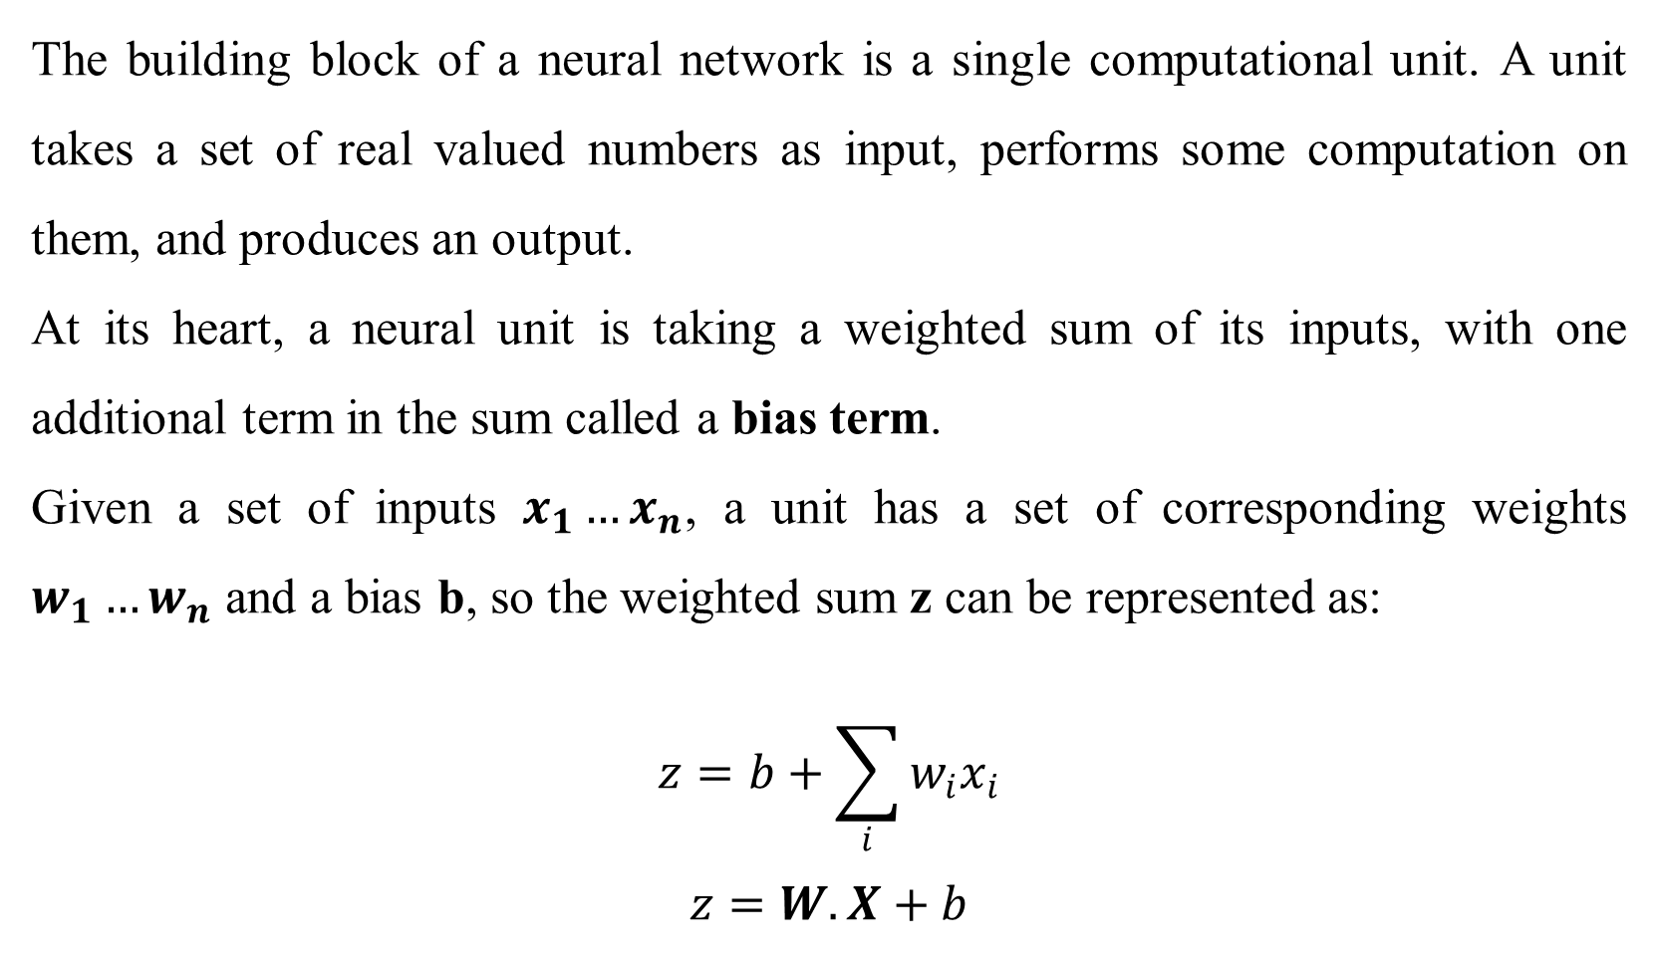
Units
The building block of a neural network is a single computational unit. A unit takes a set of real valued numbers as input, performs some computation on them, and produces an output.
At its heart, a neural unit is taking a weighted sum of its inputs, with one additional term in the sum called a bias term.
Given a set of inputs $x_{1}…x_{n}$, a unit has a set of corresponding weights $w_{1}…w_{n}$ and a bias b, so the weighted sum z can be represented as:
$$z=b+\sum_{i}{w_{i}x_{i}}$$
$$z=W.X+b$$

Slide 6
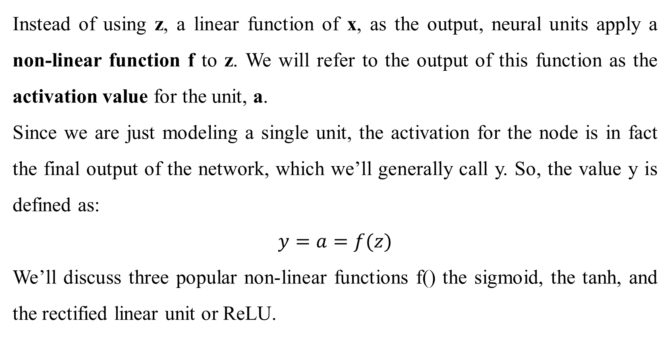
Activation
Instead of using z, a linear function of x, as the output, neural units apply a non-linear function f to z. We will refer to the output of this function as the activation value for the unit, a.
Since we are just modeling a single unit, the activation for the node is in fact the final output of the network, which we’ll generally call y. So, the value y is defined as:
$$y=a=f(z)$$
We’ll discuss three popular non-linear functions f() the sigmoid, the tanh, and the rectified linear unit or ReLU.

Slide 7
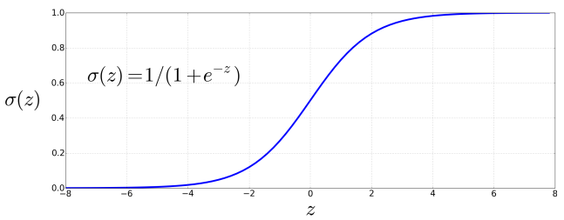

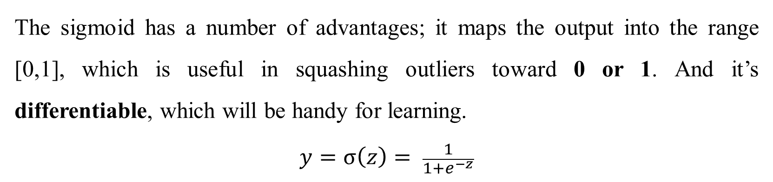
Sigmoid function
The sigmoid has a number of advantages; it maps the output into the range [0,1], which is useful in squashing outliers toward 0 or 1. And it’s differentiable, which will be handy for learning.
$$y=σ\left(z\right)= \frac{1}{1+e^{−z}}$$

Slide 8
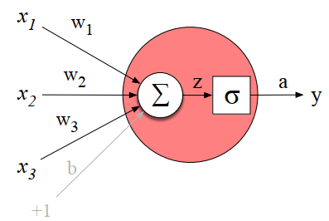
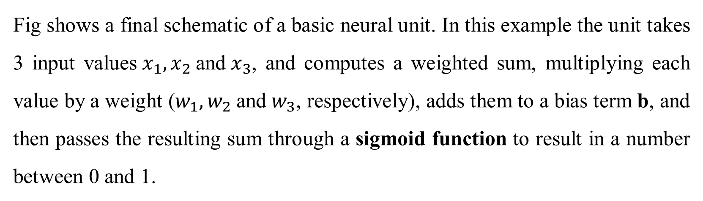
Sigmoid function
Fig shows a final schematic of a basic neural unit. In this example the unit takes 3 input values$x_{1},x_{2}$and${ x}_{3}$, and computes a weighted sum, multiplying each value by a weight ($w_{1},w_{2}$and${ w}_{3}$, respectively), adds them to a bias term b, and then passes the resulting sum through a sigmoid function to result in a number between 0 and 1.

Slide 9
Sigmoid function
Let’s walk through an example just to get an intuition. Let’s suppose we have a
unit with the following weight vector and bias:
w = [0.2, 0.3, 0.9]
b = 0.5
What would this unit do with the following input vector:
x = [0.5, 0.6, 0,1]
The resulting output y would be:

Slide 10


Tanh and ReLU function
In practice, the sigmoid is not commonly used as an activation function. A function that is very similar but almost always better is the tanh function shown in below. tanh is a variant of the sigmoid that ranges from -1 to +1:
The simplest activation function, and perhaps the most commonly used, is the rectified linear unit, also called the ReLU, shown in below. It’s just the same as z when z is positive, and 0 otherwise:

Slide 11
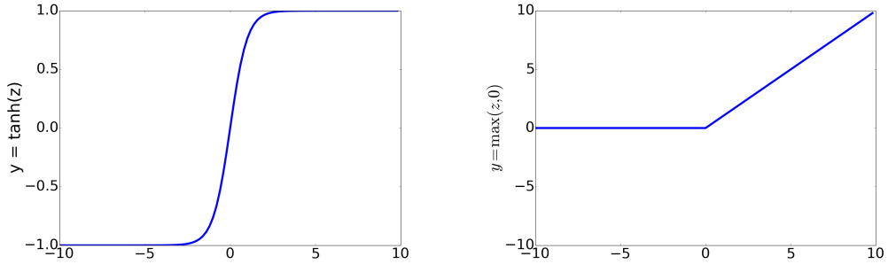
Tanh and ReLU function
These activation functions have different properties that make them useful for different language applications or network architectures.
For example, the tanh function has the nice properties of being smoothly differentiable and mapping outlier values toward the mean.
The rectifier function, on the other hand has nice properties that result from it being very close to linear.

Slide 12
Activation
In the sigmoid or tanh functions, very high saturated values of z result in values of y that are saturated, i.e., extremely close to 1, and have derivatives very close to 0.
Zero derivatives cause problems for learning, because as we’ll see, we’ll train networks by propagating an error signal backwards, multiplying gradients (partial derivatives) from each layer of the network; gradients that are almost 0 cause the error signal to get smaller and smaller until it is too small to be used for training, a problem called the vanishing gradient problem.
Rectifiers don’t have this problem, since the derivative of ReLU for high values of z is 1 rather than very close to 0.
Notes:
The vanishing gradient problem, particularly with sigmoid activation functions, occurs when gradients shrink exponentially as they propagate backward through a deep neural network during training. This makes it difficult for the early layers to learn effectively, hindering the overall training process and potentially preventing convergence.
Here's a more detailed explanation:
Why does it happen?
1. Sigmoid's Derivative:
The derivative of the sigmoid function, which is used to update weights during backpropagation, is between 0 and 0.25.
2. Multiplication in Deep Networks:
When you have many layers in a network, the gradients from the output layer are multiplied by the derivatives of each layer as they go back. This multiplication of small numbers (between 0 and 0.25) leads to an exponential decrease in the gradient's magnitude.
3. Impact on Early Layers:
By the time the gradients reach the earlier layers, their magnitude has often become so small that the weights in those layers are hardly updated, even with a large learning rate.
4. Saturated Neurons:
The sigmoid function "saturates" at the extremes (very high or very low inputs), where the output is close to 1 or 0, and the derivative is very close to zero. This further contributes to the vanishing gradient problem, especially in deep networks.

Slide 13
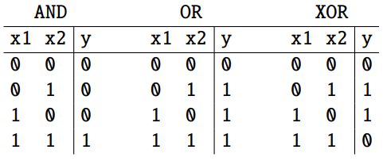

Perceptron to neural network: XOR
A single neural unit cannot compute some very simple functions of its input. Consider the task of computing elementary logical functions of two inputs, like AND, OR, and XOR.
This example was first shown for the perceptron, which is a very simple neural
unit that has a binary output and does not have a non-linear activation function.

Slide 14
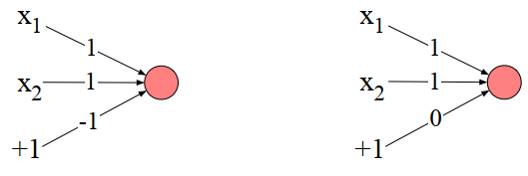
Perceptron to neural network: XOR
It’s very easy to build a perceptron that can compute the logical AND and OR
functions of its binary inputs.
It turns out, however, that it’s not possible to build a perceptron to compute logical XOR!

Slide 15
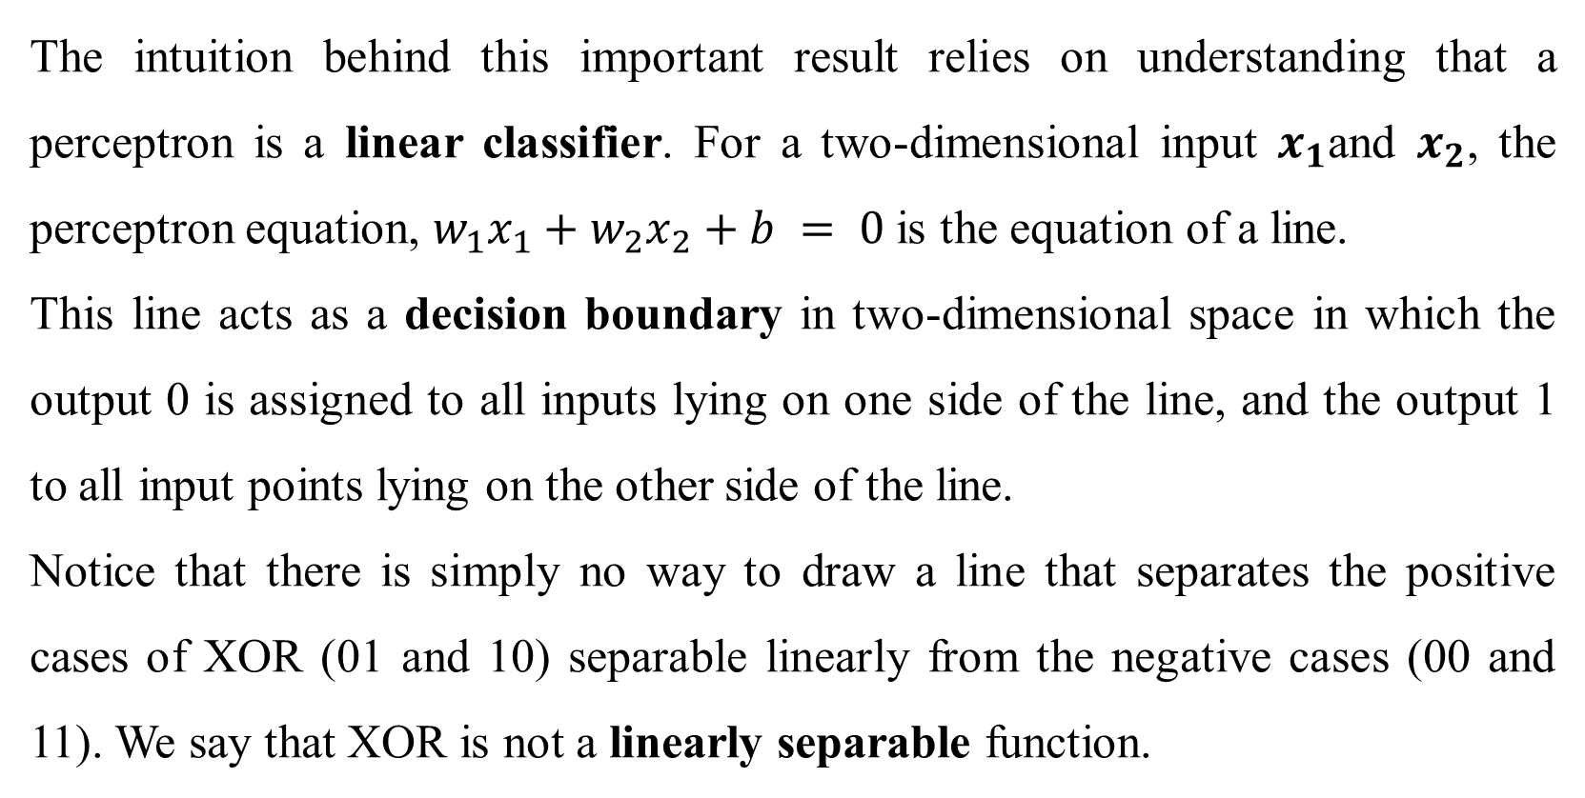
Perceptron to neural network: XOR
The intuition behind this important result relies on understanding that a perceptron is a linear classifier. For a two-dimensional input $x_{1}$and $x_{2}$, the perceptron equation, $w_{1}x_{1}+w_{2}x_{2}+b = 0$is the equation of a line.
This line acts as a decision boundary in two-dimensional space in which the output 0 is assigned to all inputs lying on one side of the line, and the output 1 to all input points lying on the other side of the line.
Notice that there is simply no way to draw a line that separates the positive cases of XOR (01 and 10) separable linearly from the negative cases (00 and 11). We say that XOR is not a linearly separable function.

Slide 16
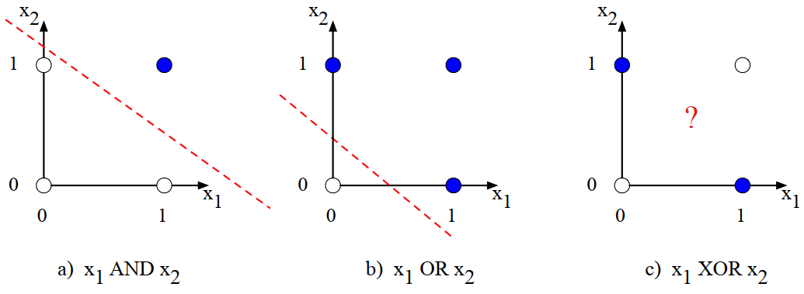
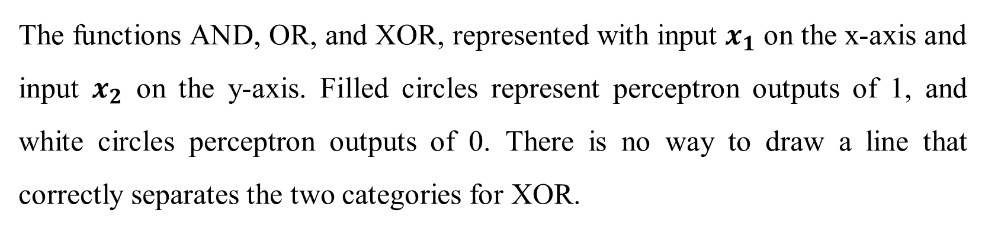
Perceptron to neural network: XOR
The functions AND, OR, and XOR, represented with input $x_{1}$ on the x-axis and input $x_{2}$ on the y-axis. Filled circles represent perceptron outputs of 1, and white circles perceptron outputs of 0. There is no way to draw a line that correctly separates the two categories for XOR.

Slide 17
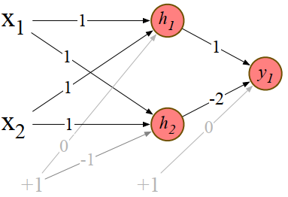
The solution: neural networks
It can be calculated by a layered network of perceptron units. Rather than see this with networks of simple perceptrons, however, let’s see how to compute XOR using two layers of ReLU-based units.
Fig. shows that the input being processed by two layers of neural units. The middle layer (called h) has two units, and the output layer (called y) has one unit. A set of weights and biases are shown for each ReLU that correctly computes the XOR function.

Slide 18
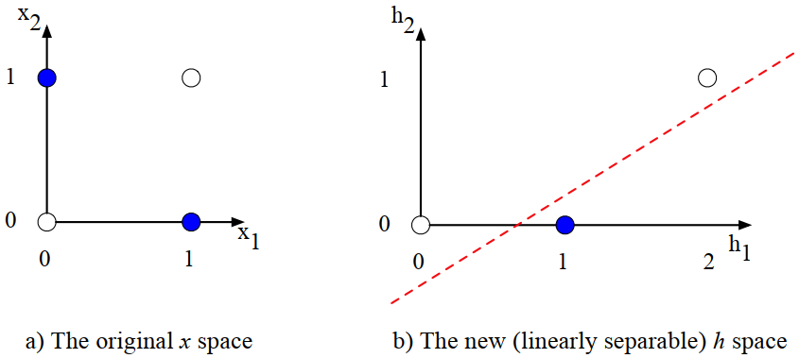
The solution: neural networks
The hidden layer forming a new representation of the input. (b) shows the representation of the hidden layer, h, compared to the original input representation x in (a).
Notice that the input point [0, 1] has been collapsed with the input point [1, 0], making it possible to linearly separate the positive and negative cases of XOR.

Slide 19
Feedforward Neural Networks
A feedforward network is a multilayer network in which the units are connected with no cycles; the outputs from units in each layer are passed to units in the next higher layer, and no outputs are passed back to lower layers.
Perceptrons are purely linear, but modern networks are made up of units with non-linearities like sigmoids.
Feedforward networks, are sometimes called multi-layer perceptrons (or MLPs); this is a technical misnomer.
Simple feedforward networks have three kinds of nodes: input units, hidden
units, and output units.

Slide 20
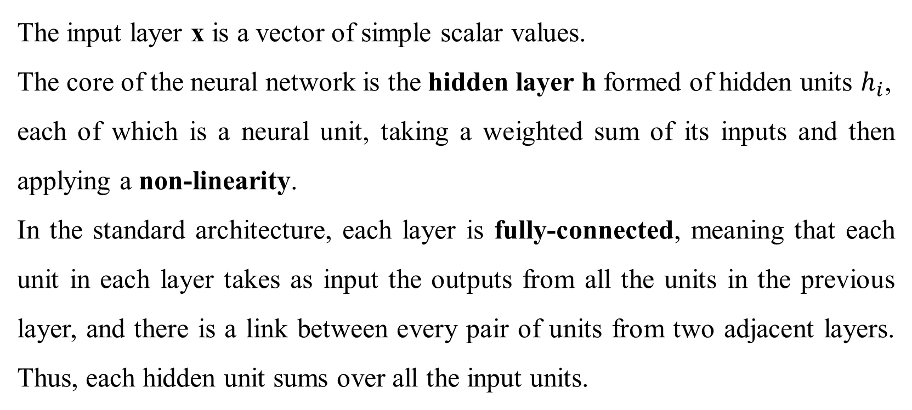
Feedforward Neural Networks
The input layer x is a vector of simple scalar values.
The core of the neural network is the hidden layer h formed of hidden units $h_{i}$,
each of which is a neural unit, taking a weighted sum of its inputs and then applying a non-linearity.
In the standard architecture, each layer is fully-connected, meaning that each unit in each layer takes as input the outputs from all the units in the previous layer, and there is a link between every pair of units from two adjacent layers. Thus, each hidden unit sums over all the input units.

Slide 21
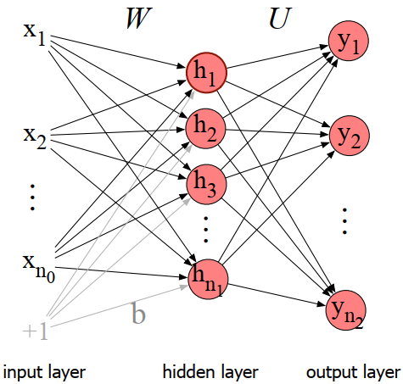
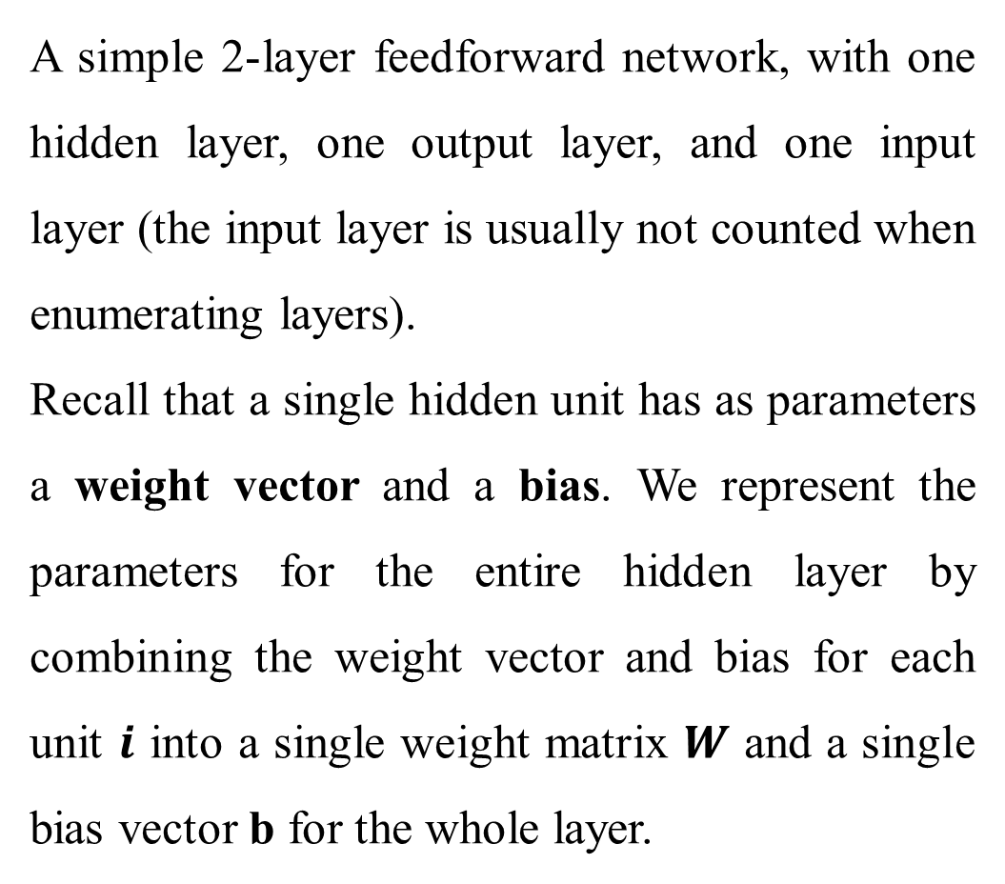
Feedforward Neural Networks
A simple 2-layer feedforward network, with one hidden layer, one output layer, and one input layer (the input layer is usually not counted when enumerating layers).
Recall that a single hidden unit has as parameters a weight vector and a bias. We represent the parameters for the entire hidden layer by combining the weight vector and bias for each unit $i$ into a single weight matrix $W$ and a single bias vector b for the whole layer.

Slide 22
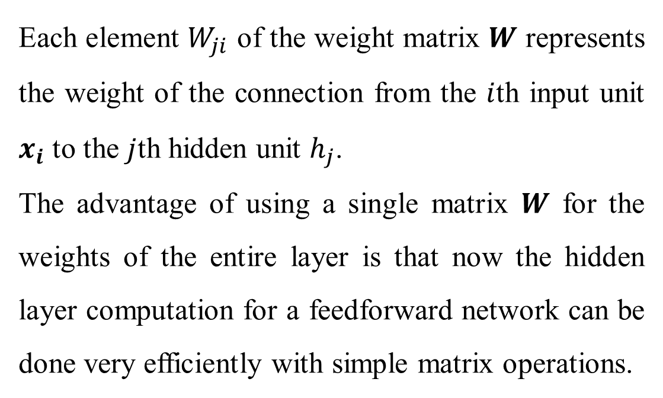
Feedforward Neural Networks
Each element $W_{ji}$ of the weight matrix $W$ represents the weight of the connection from the $i$th input unit $x_{i}$ to the $j$th hidden unit $h_{j}$.
The advantage of using a single matrix $W$ for the weights of the entire layer is that now the hidden layer computation for a feedforward network can be done very efficiently with simple matrix operations.
In fact, the computation only has three steps: multiplying the weight matrix by the input vector 𝒙, adding the bias vector b, and applying the activation function g (such as the sigmoid, tanh, or ReLU activation function).

Slide 23
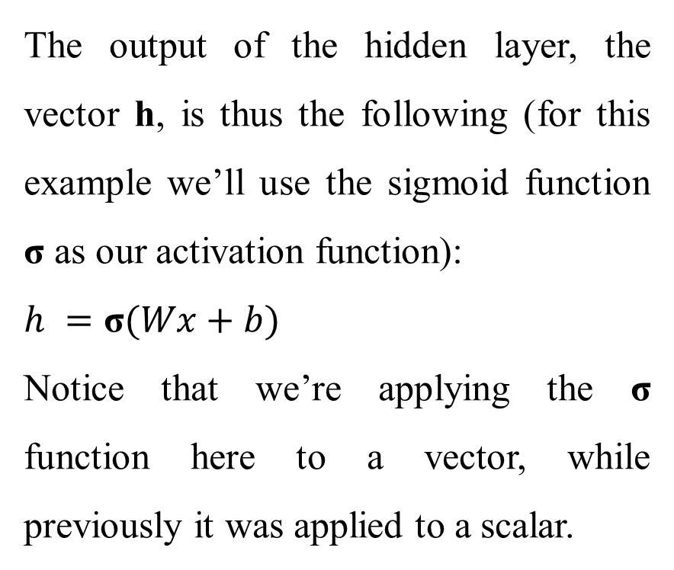
Feedforward Neural Networks
The output of the hidden layer, the vector h, is thus the following (for this example we’ll use the sigmoid function σ as our activation function):
$h =\text{σ}(Wx+b)$
Notice that we’re applying the $\text{σ}$ function here to a vector, while previously it was applied to a scalar.

Slide 24
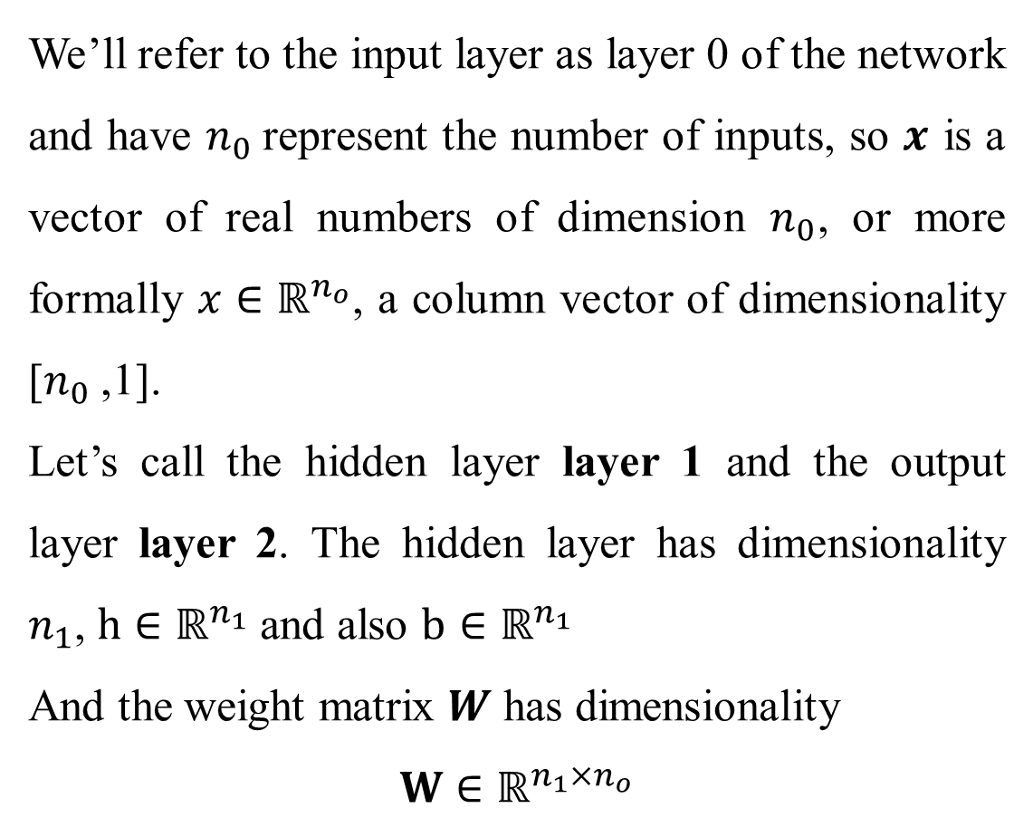
Feedforward Neural Networks
We’ll refer to the input layer as layer 0 of the network and have $n_{0}$represent the number of inputs, so $x$ is a vector of real numbers of dimension $n_{0}$, or more formally $x∈ℝ^{n_{o}}$, a column vector of dimensionality [$n_{0}$,1].
Let’s call the hidden layer layer 1 and the output layer layer 2. The hidden layer has dimensionality $n_{1}$, $h∈ℝ^{n_{1}}$and also $b∈ℝ^{n_{1}}$
And the weight matrix $W$ has dimensionality
$$W∈ℝ^{n_{1}×n_{o}}$$

Slide 25
Feedforward Neural Networks
If we are doing a binary task like sentiment classification, we might have a single output node, and its scalar value y is the probability of positive versus negative sentiment.
If we are doing multinomial classification, such as assigning a part-of-speech tag, we might have one output node for each potential part-of-speech, whose
output value is the probability of that part-of-speech, and the values of all the output nodes must sum to one.
The output layer is thus a vector y that gives a probability distribution across the output nodes.

Slide 26
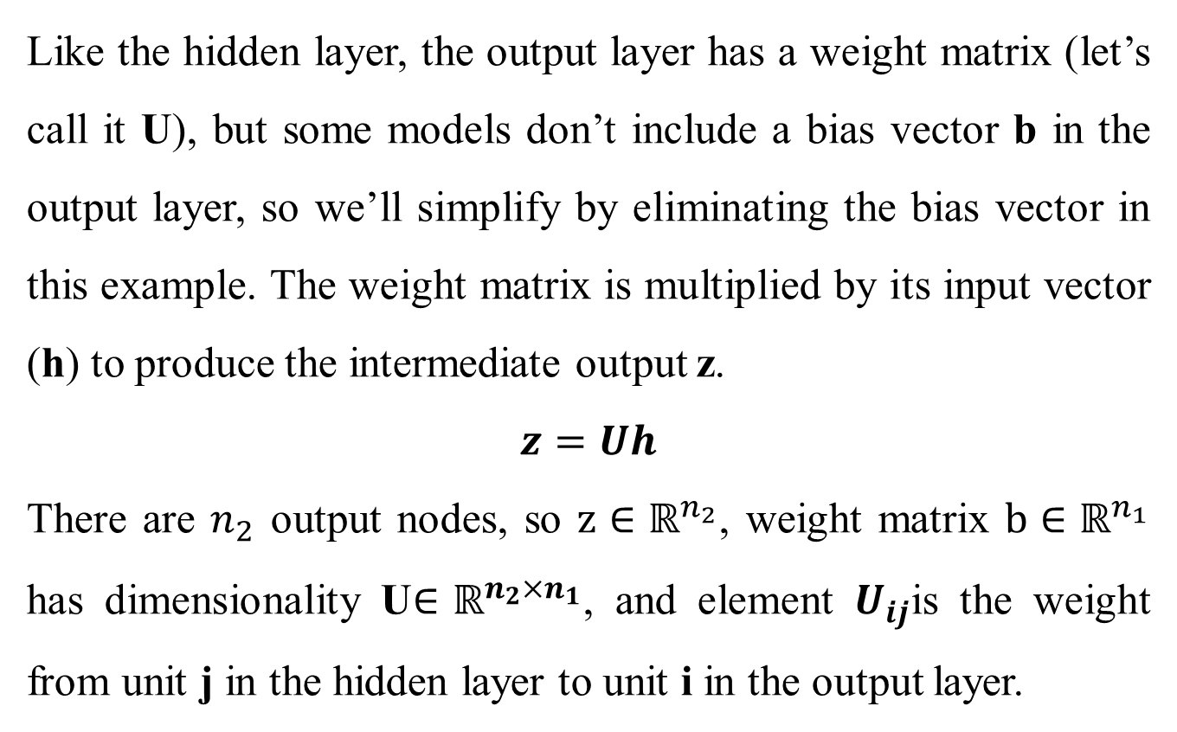
Feedforward Neural Networks
Like the hidden layer, the output layer has a weight matrix (let’s call it U), but some models don’t include a bias vector b in the output layer, so we’ll simplify by eliminating the bias vector in this example. The weight matrix is multiplied by its input vector (h) to produce the intermediate output z.
$$z=Uh$$
There are $n_{2}$ output nodes, so $z∈ℝ^{n_{2}}$, weight matrix $b∈ℝ^{n_{1}}$ has dimensionality U$∈ℝ^{n_{2}×n_{1}}$, and element $U_{ij}$is the weight from unit j in the hidden layer to unit i in the output layer.

Slide 27


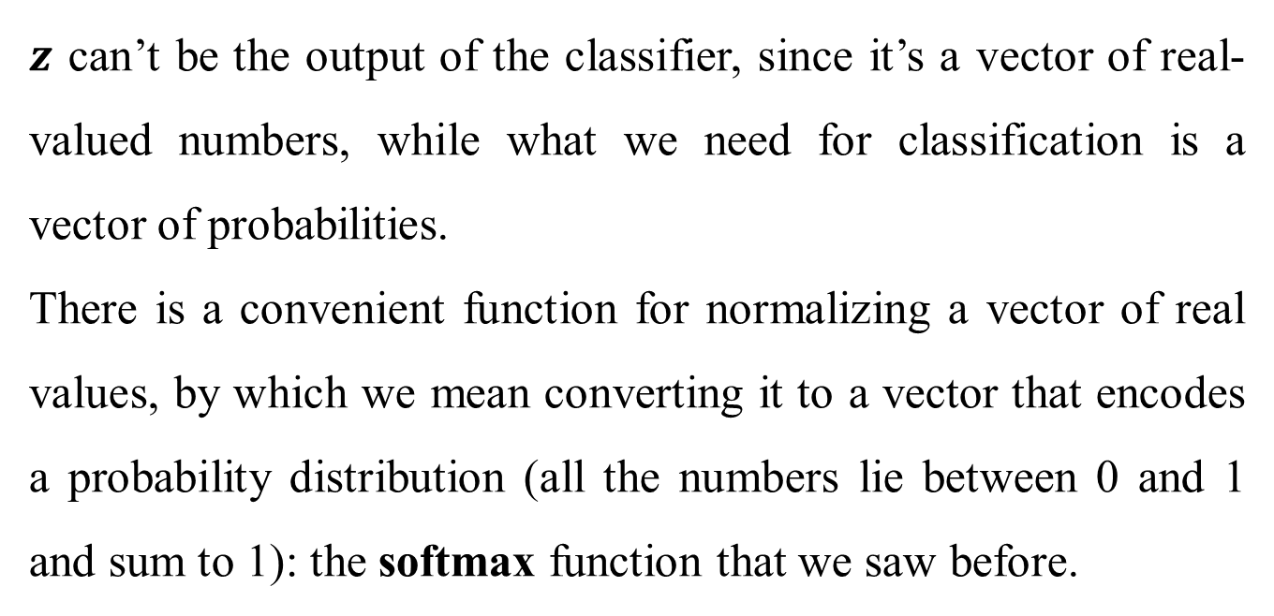
Feedforward Neural Networks
$z$ can’t be the output of the classifier, since it’s a vector of real-valued numbers, while what we need for classification is a vector of probabilities.
There is a convenient function for normalizing a vector of real values, by which we mean converting it to a vector that encodes a probability distribution (all the numbers lie between 0 and 1 and sum to 1): the softmax function that we saw before.

Slide 28
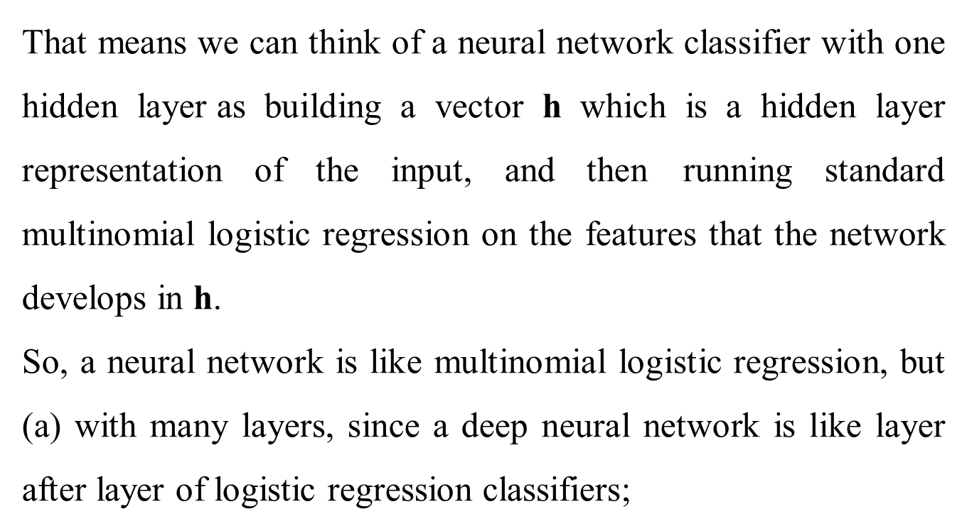
Feedforward Neural Networks
That means we can think of a neural network classifier with one hidden layer as building a vector h which is a hidden layer representation of the input, and then running standard multinomial logistic regression on the features that the network develops in h.
So, a neural network is like multinomial logistic regression, but (a) with many layers, since a deep neural network is like layer after layer of logistic regression classifiers;

Slide 29
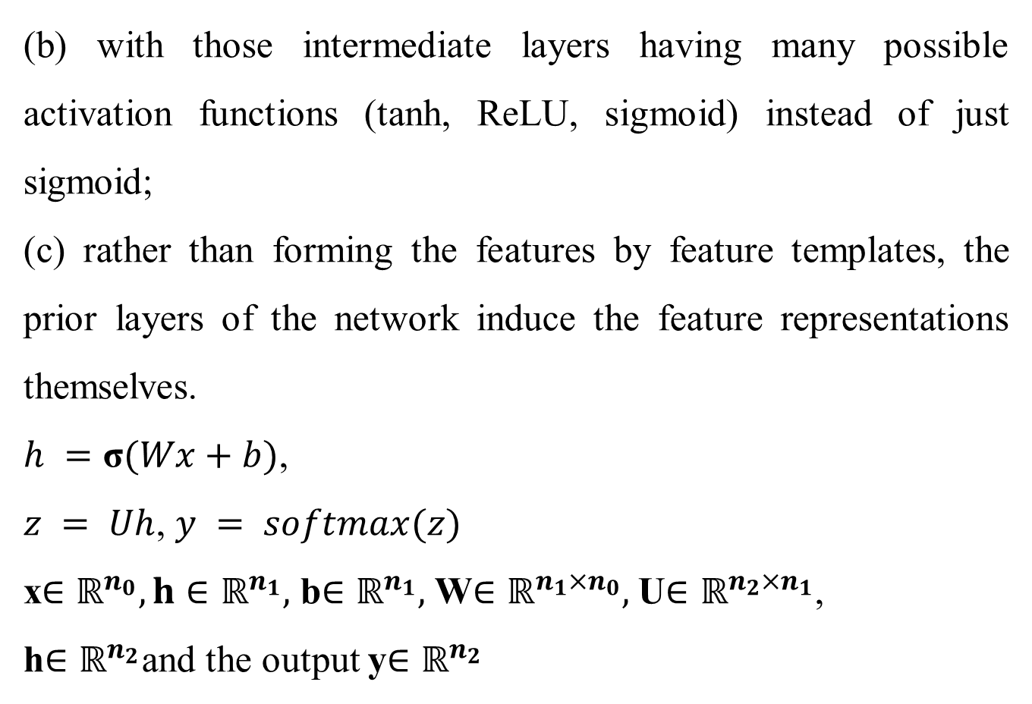
Feedforward Neural Networks
(b) with those intermediate layers having many possible activation functions (tanh, ReLU, sigmoid) instead of just sigmoid;
(c) rather than forming the features by feature templates, the prior layers of the network induce the feature representations themselves.
$h =\text{σ}(Wx+b)$,
$z = Uh$, $y = softmax(z)$
x$∈ℝ^{n_{0}}, h∈ℝ^{n_{1}},$ b$∈ℝ^{n_{1}},$W$∈ℝ^{n_{1}×n_{0}},$U$∈ℝ^{n_{2}×n_{1}}$,
h$∈ℝ^{n_{2}}$and the output y$∈ℝ^{n_{2}}$

Slide 30
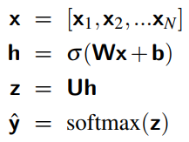
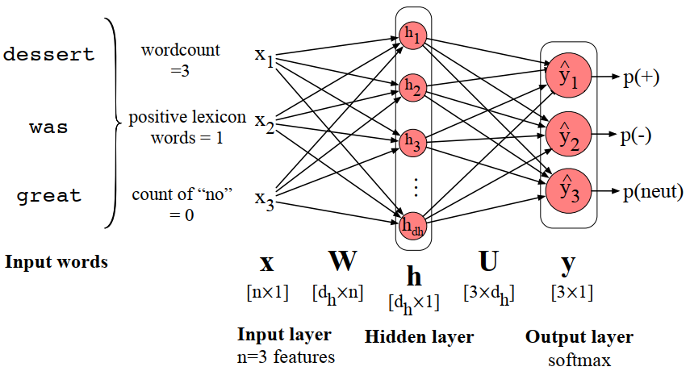
Feedforward networks for NLP: Classification
Let’s begin with a simple 2-layer sentiment classifier.

Slide 31
Feedforward networks for NLP: Classification
Most neural NLP applications do something different, however. Instead of using hand-built human-engineered features as the input to our classifier, we draw on deep learning’s ability to learn features from the data by representing words as embeddings, like the word2vec or GloVe embeddings.
There are various ways to represent an input for classification. One simple baseline is to apply some sort of pooling function to the embeddings of all the words in the input.

Slide 32

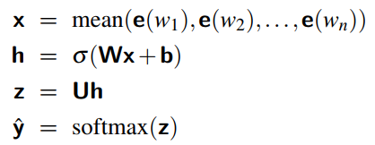
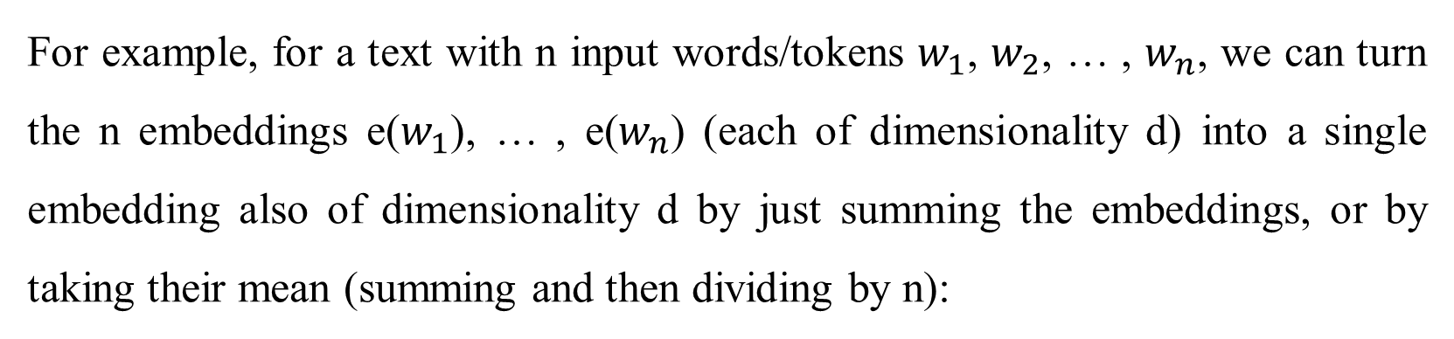
Feedforward networks for NLP: Classification
For example, for a text with n input words/tokens $w_{1}$, $w_{2}$, … , $w_{n}$, we can turn the n embeddings e($w_{1}$), … , e($w_{n}$) (each of dimensionality d) into a single embedding also of dimensionality d by just summing the embeddings, or by taking their mean (summing and then dividing by n):

Slide 33
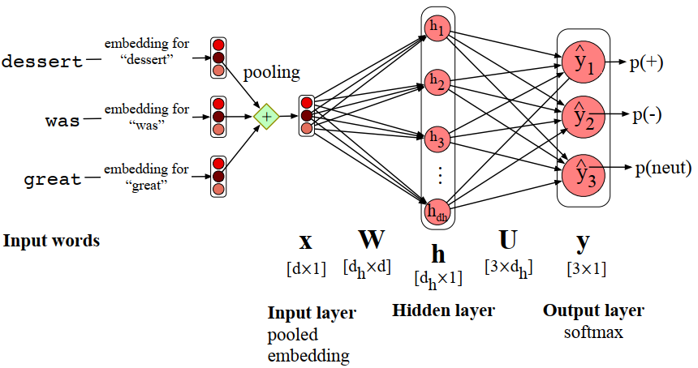
Feedforward networks for NLP: Classification
Feedforward sentiment analysis using a pooled embedding of the input words.

Slide 34
Feedforward Neural Language Modeling
As our second application of feedforward networks, let’s consider language modeling: predicting upcoming words from prior word context. Neural language modeling is an important NLP task in itself, and it plays a role in many important algorithms for tasks like machine translation, summarization, speech recognition, grammar correction, and dialogue.
We’ll describe simple feedforward neural language models, first introduced by Bengio et al. (2003). While modern neural language models use more powerful architectures like the recurrent nets or transformer networks to be introduced later, the feedforward language model introduces many of the important concepts of neural language modeling.

Slide 35
Feedforward Neural Language Modeling
Neural language models have many advantages over the n-gram language models (discussed earlier). Compared to n-gram models, neural language models can handle much longer histories, can generalize better over contexts of similar words, and are more accurate at word-prediction.
On the other hand, neural net language models are much more complex, are slower and need more energy to train, and are less interpretable than n-gram models, so for many (especially smaller) tasks an n-gram language model is still the right tool.

Slide 36

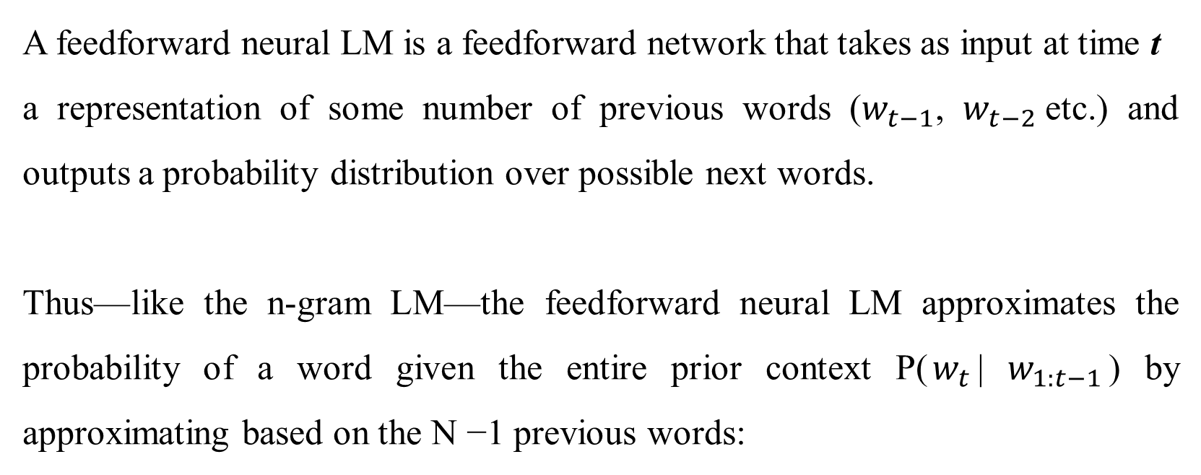
Feedforward Neural Language Modeling
A feedforward neural LM is a feedforward network that takes as input at time t
a representation of some number of previous words ($w_{t−1}$, $w_{t−2}$etc.) and outputs a probability distribution over possible next words.
Thus—like the n-gram LM—the feedforward neural LM approximates the probability of a word given the entire prior context P($w_{t}$| $w_{1:t−1}$) by approximating based on the N −1 previous words:

Slide 37

Forward inference in the neural LM
Forward inference is the task, given an input, of running a forward pass on the network to produce a probability distribution over possible outputs, in this case next words.
We first represent each of the N previous words as a one-hot vector of length |V|. A one-hot vector is a vector that has one element equal to 1—in the dimension corresponding to that word’s index in the vocabulary— while all the other elements are set to zero. Thus, in a one-hot representation for the word “toothpaste”, supposing it is V5, as shown here:

Slide 38
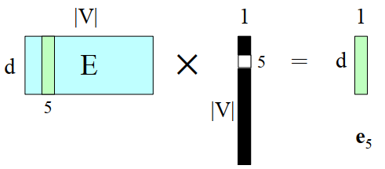
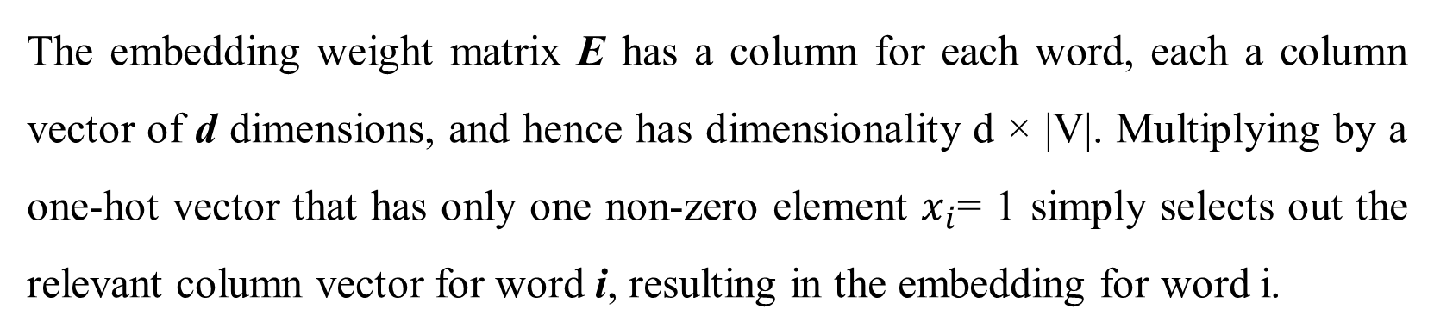
Forward inference in the neural LM
The embedding weight matrix E has a column for each word, each a column vector of d dimensions, and hence has dimensionality d × |V|. Multiplying by a one-hot vector that has only one non-zero element $x_{i}$= 1 simply selects out the relevant column vector for word i, resulting in the embedding for word i.

Slide 39
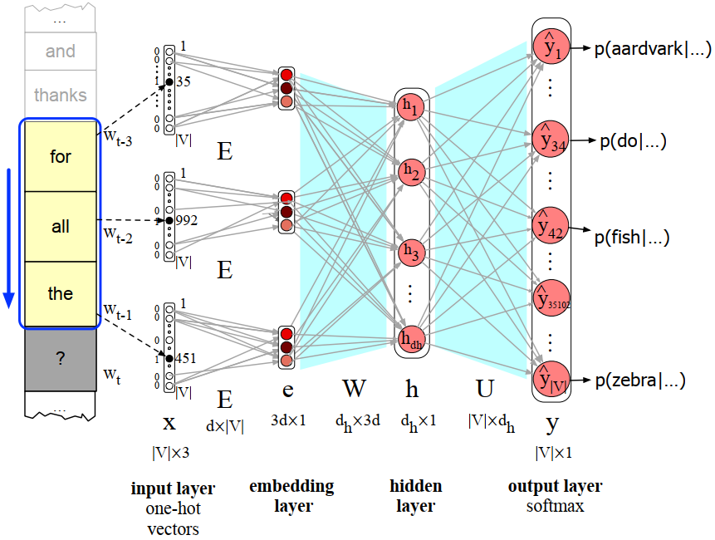
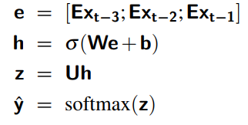
Forward inference in the neural LM
Forward inference in a feedforward neural language model. At each timestep t the network computes a d-dimensional embedding for each context word (by multiplying a one-hot vector by the embedding matrix E), and concatenates the 3 resulting embeddings to get the embedding layer e.

Slide 40
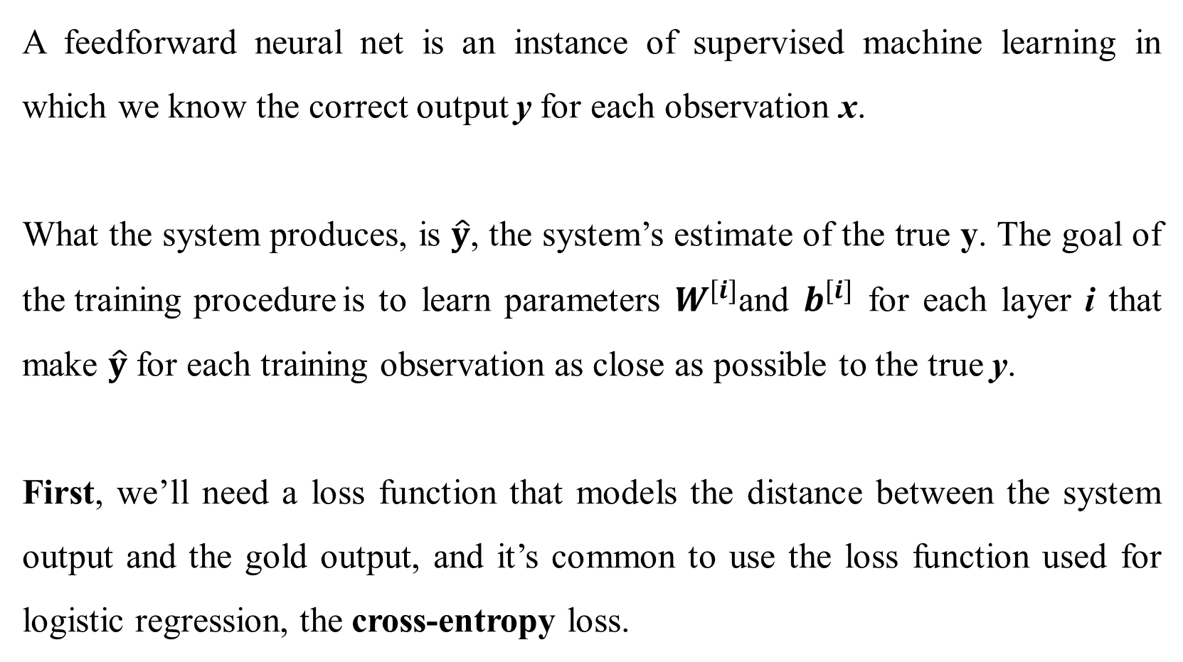
Training Neural Nets
A feedforward neural net is an instance of supervised machine learning in which we know the correct output y for each observation x.
What the system produces, is $\hat{y}$, the system’s estimate of the true y. The goal of the training procedure is to learn parameters $W^{[i]}$and $b^{[i]}$ for each layer i that make $\hat{y}$ for each training observation as close as possible to the true y.
First, we’ll need a loss function that models the distance between the system output and the gold output, and it’s common to use the loss function used for logistic regression, the cross-entropy loss.

Slide 41
Training Neural Nets
Second, to find the parameters that minimize this loss function, we’ll use the
gradient descent optimization algorithm.
Third, gradient descent requires knowing the gradient of the loss function, the
vector that contains the partial derivative of the loss function with respect to each of the parameters.
In logistic regression, for each observation we could directly compute the derivative of the loss function with respect to an individual w or b. But for neural networks, with millions of parameters in many layers, it’s much harder to see how to compute the partial derivative of some weight in layer 1 when the loss is attached to some much later layer.

Slide 42
Training Neural Nets
How do we partial out the loss over all those intermediate layers?
The answer is the algorithm called error backpropagation or backward differentiation.

Slide 43
The Backpropagation Algorithm
The goal of backpropagation is to optimize the weights so that the neural network can learn how to correctly map arbitrary inputs to outputs.
The most basic method of training a neural network is trial and error.
If the network isn't behaving the way it should, change the weighting of a random link by a random amount. If the accuracy of the network declines, undo the change and make a different one.
It takes time, but the trial and error method does produce results.

Slide 44
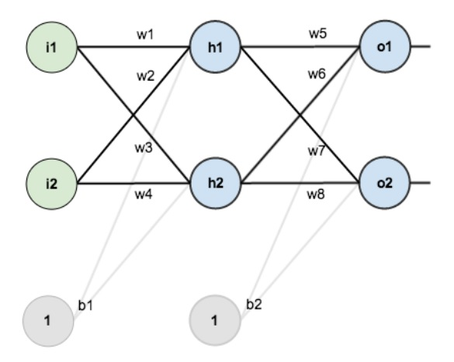
Artificial Neural Network
Learning using Back-Propagation
Sample Neural Network to Calculate Total Error Using Forward Pass Back propagation
The network contains the following:
two inputs
two hidden neurons
two output neurons
two biases
Source: https://mattmazur.com/2015/03/17/a-step-by-step-backpropagation-example/

Slide 45
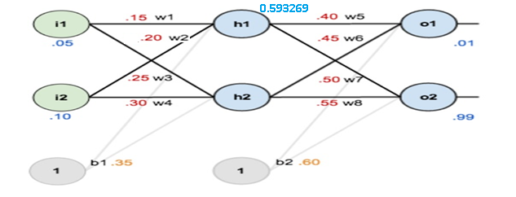
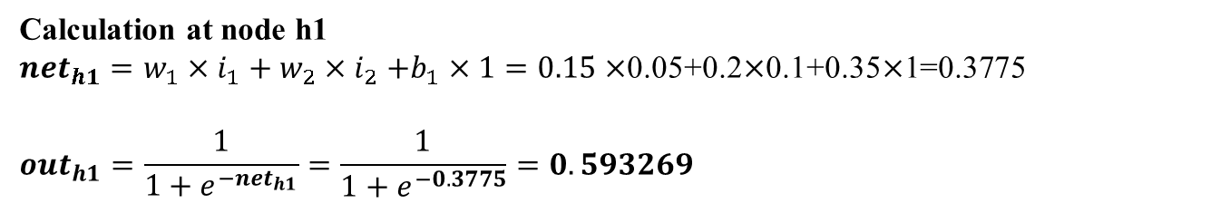
Artificial Neural Network
Learning using Back-Propagation: Error Calculation
0.05, 0.10 → 0.01, 0.99
Calculation at node h1
${net}_{h1}=w_{1}×i_{1}+w_{2}{×i}_{2}+b_{1}×1=0.15×$0.05+0.2$×$0.1+0.35$×$1=0.3775
$${out}_{h1}=\frac{1}{1+e^{−{net}_{h1}}}=\frac{1}{1+e^{−0.3775}}=0.593269$$
Source: https://mattmazur.com/2015/03/17/a-step-by-step-backpropagation-example/

Slide 46
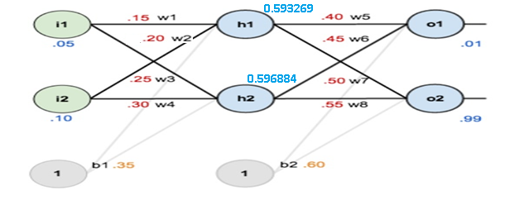
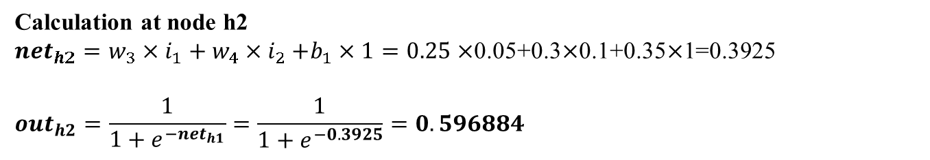
Artificial Neural Network
Learning using Back-Propagation: Error Calculation
0.05, 0.10 → 0.01, 0.99
Calculation at node h2
${net}_{h2}=w_{3}×i_{1}+w_{4}{×i}_{2}+b_{1}×1=0.25×$0.05+0.3$×$0.1+0.35$×$1=0.3925
$${out}_{h2}=\frac{1}{1+e^{−{net}_{h1}}}=\frac{1}{1+e^{−0.3925}}=0.596884$$
Source: https://mattmazur.com/2015/03/17/a-step-by-step-backpropagation-example/

Slide 47
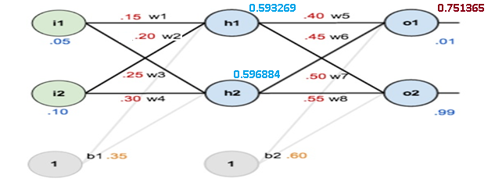
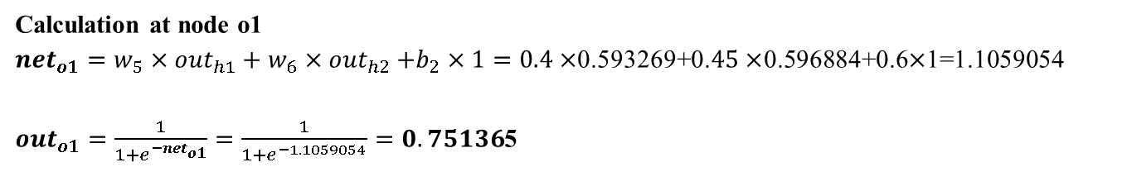
Artificial Neural Network
Learning using Back-Propagation: Error Calculation
0.05, 0.10 → 0.01, 0.99
Calculation at node o1
${net}_{o1}=w_{5}×{out}_{h1}+w_{6}{×out}_{h2}+b_{2}×1=0.4×$0.593269+0.$45×$0.596884+0.6$×$1=1.1059054
${out}_{o1}=\frac{1}{1+e^{−{net}_{o1}}}=\frac{1}{1+e^{−1.1059054}}=0.75136$5
Source: https://mattmazur.com/2015/03/17/a-step-by-step-backpropagation-example/

Slide 48
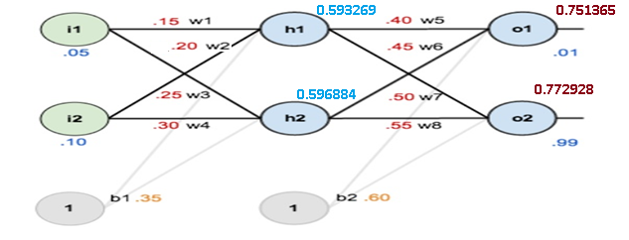
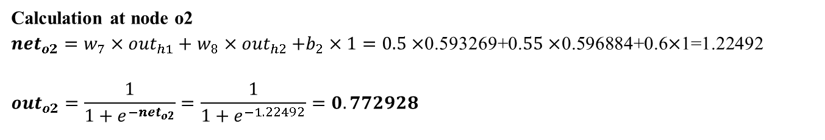
Artificial Neural Network
Learning using Back-Propagation: Error Calculation
0.05, 0.10 → 0.01, 0.99
Calculation at node o2
${net}_{o2}=w_{7}×{out}_{h1}+w_{8}{×out}_{h2}+b_{2}×1=0.5×$0.593269+0.$55×$0.596884+0.6$×$1=1.22492
$${out}_{o2}=\frac{1}{1+e^{−{net}_{o2}}}=\frac{1}{1+e^{−1.22492}}=0.772928$$
Source: https://mattmazur.com/2015/03/17/a-step-by-step-backpropagation-example/

Slide 49
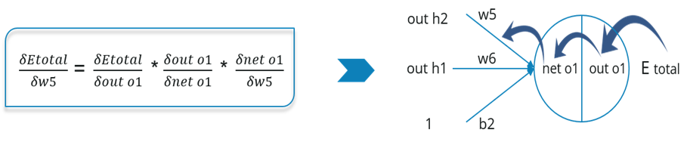
Artificial Neural Network
Propagate the error backward to adjust the weights
0.05, 0.10 → 0.01, 0.99
Now, we will propagate backwards. This way we will try to reduce the error by changing the values of weights and biases.
Consider w5, we will calculate the rate of change of error w.r.t change in weight w5.
Source: https://mattmazur.com/2015/03/17/a-step-by-step-backpropagation-example/

Slide 50
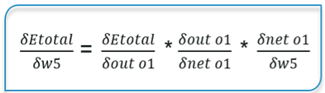
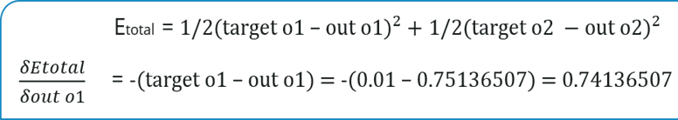
Artificial Neural Network
Propagate the error backward to adjust the weights
0.05, 0.10 → 0.01, 0.99
Since we are propagating backwards, first thing we need to do is, calculate the change in total errors w.r.t the output o1 and o2.
Source: https://mattmazur.com/2015/03/17/a-step-by-step-backpropagation-example/

Slide 51
Artificial Neural Network
Propagate the error backward to adjust the weights
0.05, 0.10 → 0.01, 0.99
Now, we will propagate further backwards and calculate the change in output o1 w.r.t to its total net input.
Source: https://mattmazur.com/2015/03/17/a-step-by-step-backpropagation-example/

Slide 52
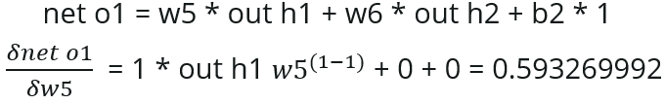
Artificial Neural Network
Propagate the error backward to adjust the weights
0.05, 0.10 → 0.01, 0.99
Let’s see now how much does the total net input of o1 changes w.r.t w5?
Source: https://mattmazur.com/2015/03/17/a-step-by-step-backpropagation-example/

Slide 53
Artificial Neural Network
Propagate the error backward to adjust the weights
0.05, 0.10 → 0.01, 0.99
Putting all the values together and calculating the updated weight value
Source: https://mattmazur.com/2015/03/17/a-step-by-step-backpropagation-example/

Slide 54
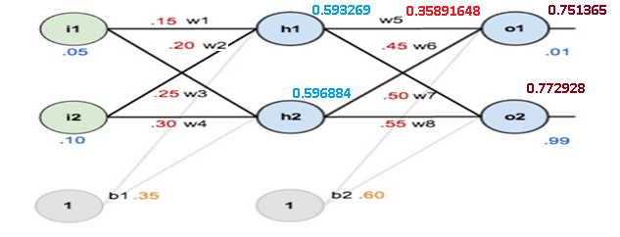
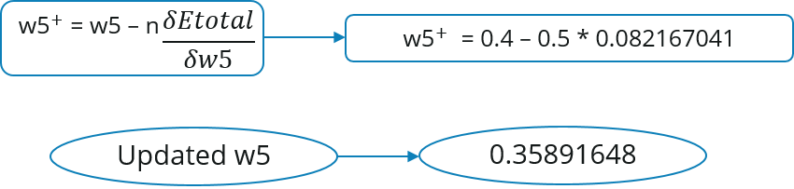
Artificial Neural Network
Propagate the error backward to adjust the weights
0.05, 0.10 → 0.01, 0.99
Let’s calculate the updated value of w5:
Source: https://mattmazur.com/2015/03/17/a-step-by-step-backpropagation-example/

Slide 55

Artificial Neural Network
Propagate the error backward to adjust the weights
0.05, 0.10 → 0.01, 0.99
Source: https://mattmazur.com/2015/03/17/a-step-by-step-backpropagation-example/

Slide 56
Artificial Neural Network
Propagate the error backward to adjust the weights
0.05, 0.10 → 0.01, 0.99
Similarly, we can calculate the other weight values as well.
After that we will again propagate forward and calculate the output. Again, we will calculate the error.
If the error is minimum we will stop right there, else we will again propagate backwards and update the weight values.
This process will keep on repeating until error becomes minimum.
Source: https://mattmazur.com/2015/03/17/a-step-by-step-backpropagation-example/

Slide 57

Learning using Back Propagation
Next, we’ll continue the backwards pass by calculating new values for w1, w2, w3 and w4

Slide 58

Learning using Back Propagation

Slide 59

Learning using Back Propagation

Slide 60

Learning using Back Propagation

Slide 61


Learning using Back Propagation

Slide 62

Learning using Back Propagation
Finally, we’ve updated all of our weights! When we fed forward the 0.05 and 0.1 inputs originally, the error on the network was 0.298371109. After this first round of backpropagation, the total error is now down to 0.291027924.
It might not seem like much, but after repeating this process 10,000 times, for example, the error plummets to 0.0000351085. At this point, when we feed forward 0.05 and 0.1, the two outputs neurons generate 0.015912196 (vs 0.01 target) and 0.984065734 (vs 0.99 target).

Slide 63
Learning using Back Propagation
Similarly, we can calculate the other weight values as well.
After that we will again propagate forward and calculate the output. Again, we will calculate the error.
If the error is minimum we will stop right there, else we will again propagate backwards and update the weight values.
This process will keep on repeating until error becomes minimum.

